Slide 1


Chapter 1 Introduction to Data Management
Instructor: He Li
Notes:
This chapter provides an introduction of what is data management and its prevalence, distinguishing data and information, major data processing approaches, and the framework of data management that guides the flow of this course.

Slide 2

Data Management
is a discipline that focuses on the proper generation, storage, and retrieval of data.
Why do we need data management?
In today’s world, Data is
Ubiquitous (i.e., abundant, global, and everywhere)
Pervasive (i.e., unescapable, prevalent, and persistent)

Slide 3
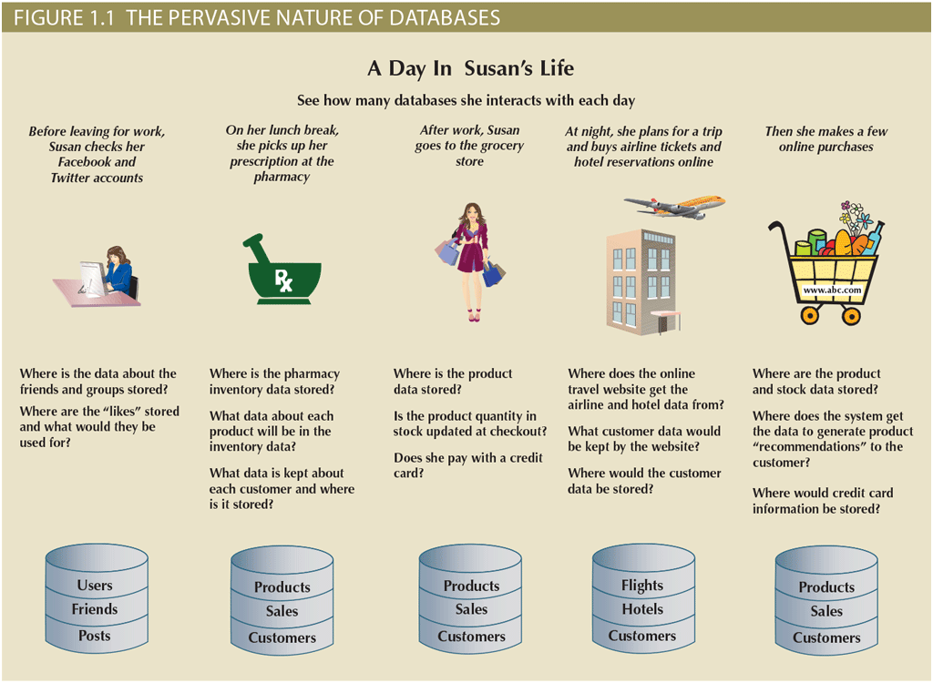
Notes:
Looking at this figure, can you identify some of the data generated by your own daily activities?
In this example, we see data related to social network sites, medical information, grocery shopping, airlines, and online purchases.

Slide 4
Data Management for business …
Data Collection
Data Storage
Data Manipulation
Data Aggregation
Data Dissemination
Data Management
Data Assets
Customer data
HR data
Financial data
Product data
Transaction data
Social media data
… …
Data as
Organizational Resources
Notes:
In addition to the ubiquitous and pervasive nature of data, it is also essential for organizations to survive and prosper. Imagine trying to operate a business without knowing who your customers are, what products you are selling, who is working for you, who owes you money, and to whom you owe money. All businesses have to keep this type of data and much more. Just as important, they must have that data available to decision makers when necessary. It can be argued that the ultimate purpose of all business information systems is to help businesses use information as an organizational resource.
At the heart of all these data management systems are the collection, storage, aggregation, manipulation, dissemination, and management of data.

Slide 5
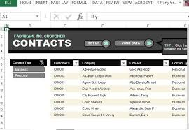


Size and Complexity of Data varies …
Customer Contact Lists
AT&T’s trillions of phone calls Data
Google responds to over 91 million searches per day
Notes:
Depending on the type of information systems and the characteristics of the business, this data could vary from a few megabytes on just one or two topics to terabytes covering hundreds of topics within the business’s internal and external environment.
For example, a salesperson may maintain a small database of customer contacts, consisting of a few megabytes of data on his/her laptop computer.
AT&T uses systems to keep data on trillions of phone calls, with new data being added to the system at speeds up to 70,000 calls per second! AT&T has to not only store and manage large size of data but also has to be able to find any given fact in that data quickly.
Google, as another example, is estimated to respond to over 91 million searches per day. The results of these searches are available almost instantly.
How can these businesses process this much data? How can they store it all, and then quickly retrieve just the facts that decision makers want to know, just when they want to know it? The answer is that they use data management tools such as databases.

Slide 6

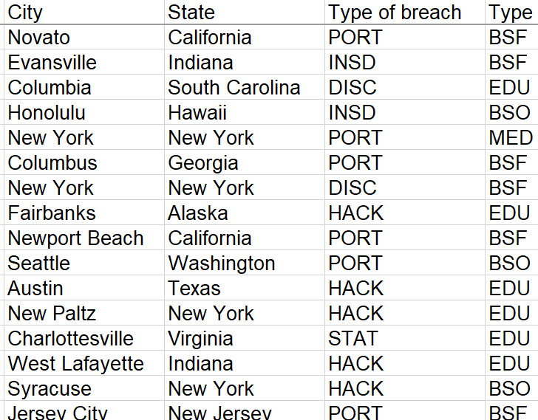


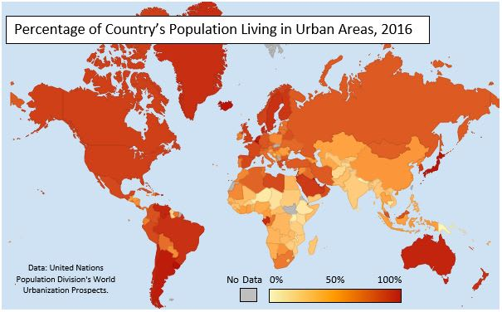




Applications of Database
Multimedia data
Fitness tracking data
Numeric and alphanumeric data
Geographical data
Biometric data
Volatile data
Big data
Notes:
There are also many examples of database applications. Most common one is the traditional numeric and alphanumeric data, which uses the relational databases.
Databases also can store multimedia data such as pictures, audio, and video – YouTube and Spotify support the querying of music based upon artist, genre, playlist, and record label.
Biometric data such as fingerprints, are often used for security, such as border control as you enter a country.
Information is also gathered by wearables such as Fitbit and Apple Watch, which continuously monitor and analyze your health and fitness.
Geographical information system (GIS) applications, such as Google Maps, store and retrieve all types of spatial or geographical data.
Database also can store and retrieve volatile data. For example, high-frequency trading, where automated, algorithmic platforms are used by investment banks or hedge funds to process a large number of orders at extremely high speed based upon events happening in the environment for macro-economy.
You may also hear about big data, which refers to large amounts of data in various forms analyzed by companies. Look at Walmart, America’s largest retailer with over 11,000 locations worldwide. Its points-of-sale (POS) database system stores an enormous amount of data, such as which customers bought what products, in what quantities, at which location, and at what time.

Slide 7
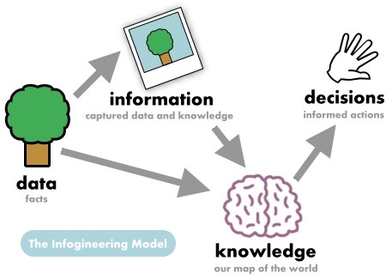
Notes:
Data and information are closely related and in fact are often used interchangeably. However, it is useful to distinguish between data and information.
Data consists of raw facts. The word raw indicates that the facts have not yet been processed to reveal their meaning. Data generally includes structured data such as numerical, text, and dates, as well as unstructured data including images, videos, audio, and documents, etc.
Information is the result of processing raw data to reveal its meaning. Information can be defined as the data that has been processed in such a way as to increase the knowledge of the person who uses the data. Data processing can be as simple as organizing data to reveal patterns or as complex as making forecasts or drawing inferences using statistical modeling. To reveal meaning, information requires context. For example, an average temperature reading of 105 degrees does not mean much unless you also know its context: Is this reading in degrees Fahrenheit or Celsius? Is this a machine temperature, a body temperature, or an outside air temperature?

Slide 8
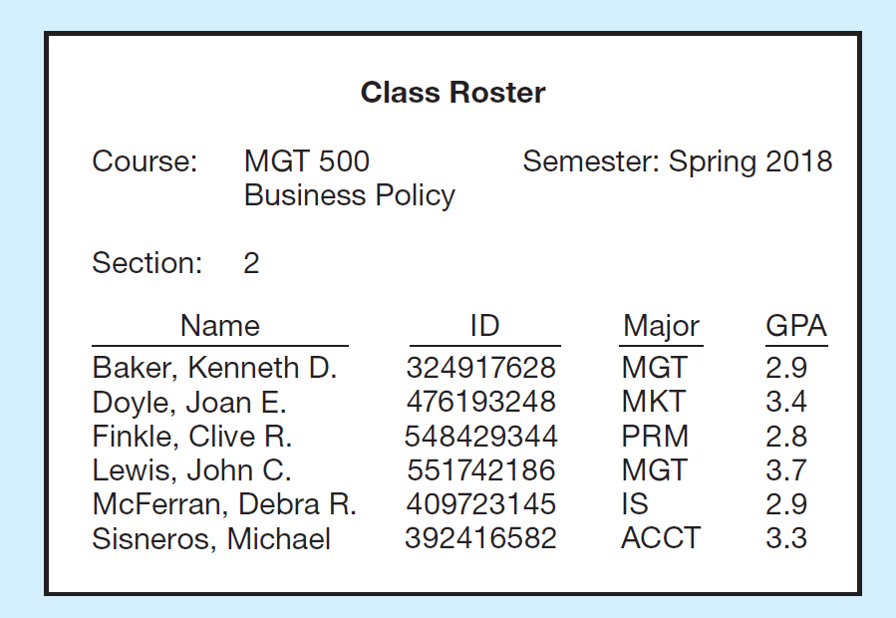

Example: from Data to Information
Raw Data
Summarized Data
Data in Context
Notes:
Let’s look at this simple example. The row data is a list of facts. These facts satisfy our definition of data, but most people would agree that the data are useless in their present form. Even if you guessed that this is a list of people’s names paired with their social security numbers, the data remain useless because you would have no idea what the entries mean.
If you see the data in a context, like this right-side figure. By adding a few additional data items and providing some structure, you are able to recognize a class roster for a particular course. This is useful information to some users, such as the course instructor and the registrar’s office. Of course, as general awareness of the importance of strong data security has increased, few organizations use social security numbers as identifiers any longer. Instead, most organizations use an internally generated number for identification purposes.
Another way to convert data into information is to summarize them or otherwise process and present them for human interpretation. For example, this figure shows summarized student enrollment data presented as graphical information. This information could be used as a basis for deciding whether to add new courses or to hire new faculty members.
In practice, according to the definition, database today may contain data, information, or both. For example, a database may contain an image of the class roster document. Also, data is often preprocessed and stored in summarized form in databases that are used for decision support. So, we will use the term database without distinguishing its contents as data or information.

Slide 9
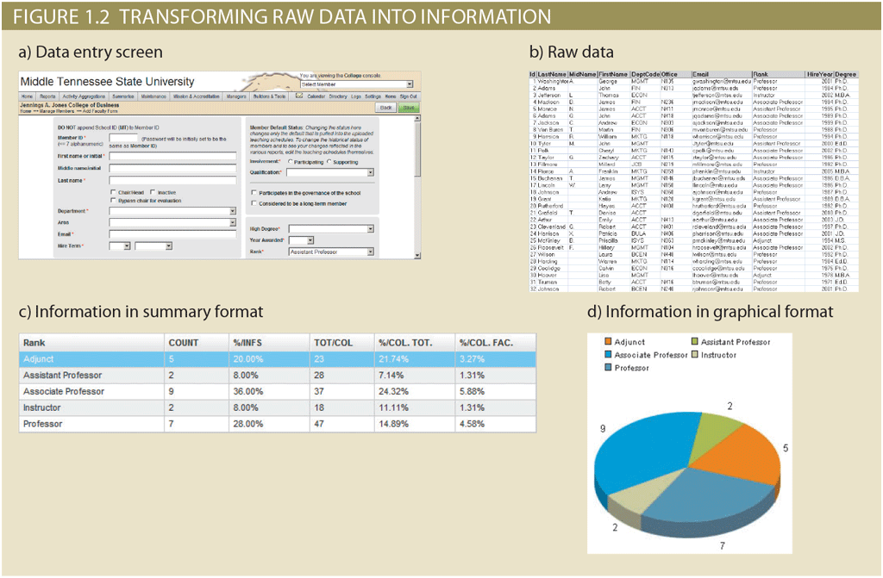
Example: from Data to Information
Data Entry Screen
Raw Data
Information in Summary Format
Information in Graphical Format
Notes:
Another similar example, suppose that a university tracks data on faculty members for reporting to accrediting bodies. To get the data for each faculty member into the database, you would provide a screen to allow for convenient data entry, complete with drop-down lists, combo boxes, option buttons, and other data-entry validation controls.
When the data is entered into the form and saved, it is placed in the underlying database as raw data. Although you now have the facts in hand, they are not particularly useful in this format. Reading through hundreds of rows of data for faculty members does not provide much insight into the overall makeup of the faculty.
Therefore, you transform the raw data into a data summary like this. Now you can get quick answers to questions such as “What percentage of the faculty in the Information Systems department are Associate Professors?”
Because graphics can enhance your ability to quickly extract meaning from data, you show the data summary pie chart.
Information can be used as the foundation for decision-making. For example, the data summary for the faculty can provide accrediting bodies with insights that are useful in determining whether to renew accreditation for the university.

Slide 10
Summary: Data → Information
Data constitutes the building blocks of information.
Information is produced by processing data.
Information is used to reveal the meaning of data.
Accurate, relevant, and timely information is the key to good decision making.
Good decision making is the key to organizational survival in a global environment.

Slide 11



File System Data Processing
Manual File Systems
Computerized File Systems
File Systems Redux
Notes:
Traditionally, we manage the data through file system data processing.
Manual File Systems: To be successful, an organization must develop systems for handling core business tasks. Historically, such systems were often manual, paper-and-pencil systems. The papers within these systems were organized to facilitate the expected use of the data. Typically, this was accomplished through a system of file folders and filing cabinets. As long as a collection of data was relatively small and an organization’s business users had few reporting requirements, the manual system served its role well as a data repository. However, as organizations grew and as reporting requirements became more complex, keeping track of data in a manual file system became more difficult. Therefore, companies looked to computer technology for help.
Computerized File Systems: With the computerized file system approach, a data processing (DP) specialist was hired to create a computer-based system that would track data and produce required reports. Initially, the computer files within the file system were similar to the manual files.
When business users wanted data from the computerized file, they sent requests for the data to the DP specialist. For each request, the DP specialist had to create programs to retrieve the data from the file, manipulate it in whatever manner the user had requested, and present it as a printed report. If a request was for a report that had been run previously, the DP specialist could rerun the existing program and provide the printed results to the user. As the business grows and increasing use of data, the DP specialist was asked to create the AGENT file. The data in the AGENT file was used to write checks, keep track of taxes paid, and summarize insurance coverage, among other tasks.
File System Redux: The users’ desire for direct, hands-on access to data helped to fuel the adoption of personal computers for business use. Personal computer spreadsheet programs such as Microsoft Excel are widely used by business users, and they allow the user to enter data in a series of rows and columns so the data can be manipulated using a wide range of functions. The popularity of spreadsheet applications has enabled users to conduct sophisticated data analysis that has greatly enhanced their ability to understand the data and make better decisions. However, due to the large number of users with spreadsheets, each making separate copies of the data, the resulting “file system” of spreadsheets suffers from the same problems as the file systems created by the early DP specialists.

Slide 12
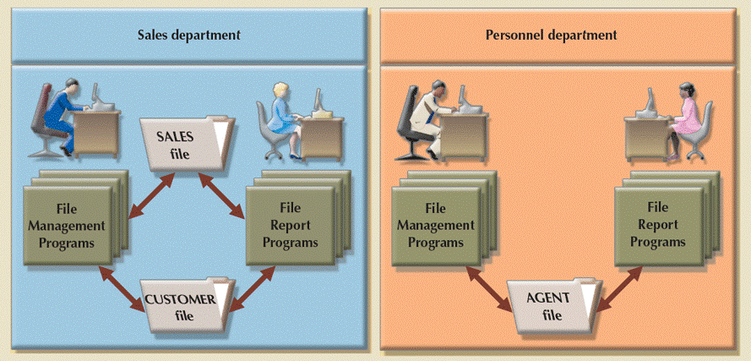
Disadvantages of File System Data Processing
Program-Data Dependence
Duplication of Data
Limited Data Sharing
Lengthy Development Times
Excessive Program Maintenance
Notes:
In summary, with the file system data processing, each file in the system uses its own application program to store, retrieve, and modify data. Also, each file was owned by the individual or the department that commissioned its creation.
This file processing systems approach has several limitations.
Program-Data Dependence: File descriptions are stored within each database application program that accesses a given file. It is difficult to locate all programs affected by a change. Worse, errors are often introduced when making such changes.
Duplication of Data: Unplanned duplicate data files are the rule rather than the exception. For example, Inventory Pricing File may be included in both Order Filling System and Invoicing System. This duplicate file not only waste storage resources, but also increase inconsistency of data.
Limited Data Sharing: Each application has its own private files, and users have little opportunity to share data outside their own applications.
Lengthy Development Times: With the traditional file processing systems, each new application requires that the developer essentially start from scratch by designing new file formats and description and then writing the fie access logic for each new program.
Excessive Program Maintenance: The preceding factors all combined to create a heavy program maintenance load in organizations that relied on traditional file processing systems. In fact, as much as 80 percent of the total information system’s development budget might be devoted to program maintenance in such organizations.

Slide 13
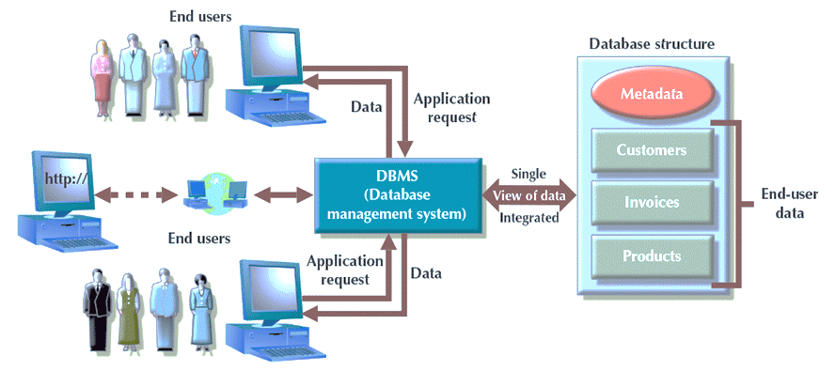
The Database Approach
Notes:
The problems inherent in file systems make using a database system very desirable. Unlike the file system, with its many separate and unrelated files, the database consists of logically related data stored in a single logical data repository.
The database’s Database Management Systems (DBMS) provides numerous advantages over file system management, by making it possible to eliminate most of the file system’s data inconsistency, data anomaly, data dependence, and structural dependence problems. A DBMS is a collection of programs that manages the database structure and controls access to the data stored in the database.
The DBMS serves as the intermediary between the user and the database. The database structure itself is stored as a collection of files, and the only way to access the data in those files is through the DBMS. The DBMS presents the end user (or application program) with a single, integrated view of the data in the database. The DBMS receives all application requests and translates them into the complex operations required to fulfill those requests. The DBMS hides much of the database’s internal complexity from the application programs and users. The application program might be written by a programmer using a programming language, such as Visual Basic.NET, Java, or C#, or it might be created through a DBMS utility program.
The primary purpose of a DBMS is to provide a systematic method of creating, updating, storing, and retrieving the data stored in a database.
It enables end-users and application programmers to share data, and it enables data to be shared among multiple applications rather than propagated and stored in new files for every new application.
A DBMS also provides facilities for controlling data access, enforcing data integrity, managing concurrency control, and restoring a database.

Slide 14
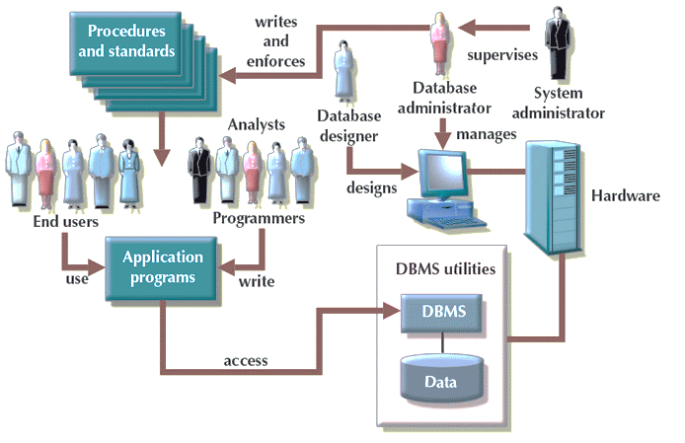
Database System Environment
Notes:
From a general management point of view, a database system often consists of five major parts: hardware, software, people, procedures, and data.
Hardware refers to all the system’s physical devices, including computers (PCs, tablets, workstations, servers, and supercomputers), storage devices, printers, network devices (hubs, switches, routers, fiber optics), and other devices (automated teller machines, ID readers, and so on).
Software. Although the most readily identified software is the DBMS itself, three types of software are needed to make the database system function fully: operating system software, DBMS software, and application programs and utilities.
Operating system software manages all hardware components and makes it possible for all other software to run on the computers. Examples of operating system software are Microsoft Windows, Linux, Mac OS, UNIX, and MVS.
DBMS software manages the database within the database system. Some examples of DBMS software are Microsoft’s SQL Server, Oracle Corporation’s Oracle, Oracle’s MySQL, and IBM’s DB2.
Application programs and utility software are used to access and manipulate data in the DBMS and to manage the computer environment in which data access and manipulation take place. Application programs are most commonly used to access data within the database to generate reports, tabulations, and other information to facilitate decision making. Utilities are the software tools used to help manage the database system’s computer components. For example, all of the major DBMS vendors now provide graphical user interfaces (GUIs) to help create database structures, control database access, and monitor database operations.
People. This component includes all users of the database system. On the basis of primary job functions, five types of users can be identified in a database system: system administrators, database administrators, database designers, system analysts and programmers, and end users. Each user type, described next, performs both unique and complementary functions.
System administrators oversee the database system’s general operations.
Database administrators, also known as DBAs, manage the DBMS and ensure that the database is functioning properly.
Database designers design the database structure. They are, in effect, the database architects. If the database design is poor, even the best application programmers and the most dedicated DBAs cannot produce a useful database environment. Because organizations strive to optimize their data resources, the database designer’s job description has expanded to cover new dimensions and growing responsibilities.
System analysts and programmers design and implement the application programs. They design and create the data-entry screens, reports, and procedures through which end users access and manipulate the database’s data.
End users are the people who use the application programs to run the organization’s daily operations. For example, sales clerks, supervisors, managers, and directors are all classified as end users. High-level end users employ the information obtained from the database to make tactical and strategic business decisions
Procedures are the instructions and rules that govern the design and use of the database system. Procedures are a critical, although occasionally forgotten, component of the system. Procedures play an important role in a company because they enforce the standards by which business is conducted within the organization and with customers. Procedures also help to ensure that companies have an organized way to monitor and audit the data that enter the database and the information generated from those data.
Data covers the collection of facts stored in the database. Because data is the raw material from which information is generated, determining which data to enter into the database and how to organize that data is a vital part of the database designer’s job.

Slide 15
Advantages of Database Approach
Program data independence
Planned data redundancy
Data consistency
Data Quality
Data sharing
Application development productivity
Standards
Data accessibility
Maintenance
Decision support
Notes:
Having a DBMS between the end user’s applications and the database offers some important advantages.
Program data independence: The separation of data descriptions (meta-data) from the application programs that use the data is called data independence. In the database approach, data descriptions are stored in a central location called the repository. This property of database systems allows an organization’s data to change and evolve (with limits) without changing the application programs that process the data.
Planned data redundancy: Good database design attempts to integrate previously separate and redundant data files into a single, logical structure. The database approach does not eliminate redundancy entirely, but it enables the designer to control the type and amount of redundancy. At other times, it may be desirable to include some limited redundancy to improve database performance, as you will see in later chapters.
Improved data consistency: By eliminating or controlling data redundancy, we can reduce in consistency. For example, if a customer’s address is stored only once, we cannot disagree about the customer’s address. If the customer changes the address, recording the new address is greatly simplified because the address is stored in a single place.
Improved data sharing: A database is designed as a shared corporate resource. Authorized users can use the database, and each user is provided one or more user views into the database. For example, the views for the human resources employee and the customer are drawn from completely different areas of one unified database.
Increased application development productivity: Database applications can be developed much more rapidly than conventional file applications. For example, the developers can focus on the specific functions without having to worry about file design or low-level implementation details. The database management systems provides several productivity tools such as report generators.
Enforcement of standards: When the database approach is implemented, the database administration function should be granted single-point authority and responsibility for establishing and enforcing data standards, including naming conventions, data quality standards, and uniform procedures for accessing, updating, and protecting data.
Improved data quality: The database approach provides tools and processes to improve data quality. For instance, database designer can specify integrity constraints that are enforced by the database management systems. Data warehouse environment also can clean up operational data before they are loaded to the data warehouse.
Improved data accessibility and responsiveness: Users can write queries to retrieve and display data.
Reduced program maintenance: Stored data need to be changed sometimes for many reasons such as new data item types are added. In a database environment, we can change either the data or the application programs that use the data without necessitating a change in the other factor since they are independent.
Improved decision support: Some databases are designed expressly for decision support applications. For example, a database can be designed to support customer relationship management.

Slide 16
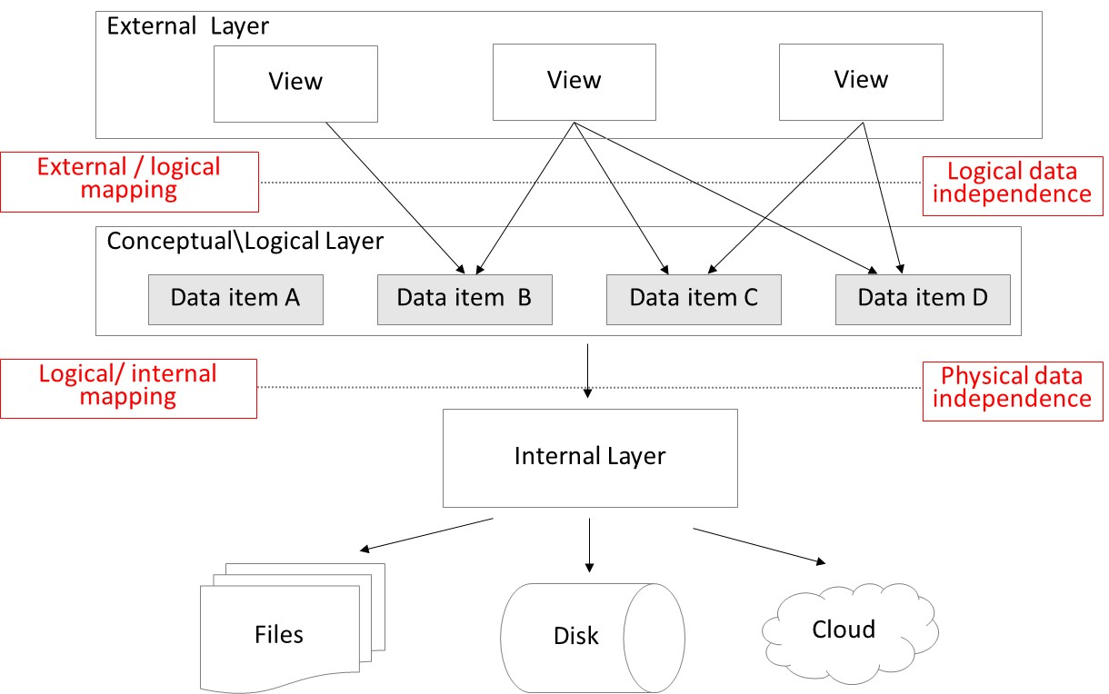
Three-Layer Database Architecture
Notes:
The three-layer architecture is an essential element of every database application and describes how the different underlying data models are related.
We start with the conceptual/logical layer. Here, we have the conceptual and logical data models. Both focus on the data items, their characteristics, and relationships without bothering too much about the actual physical DBMS implementation. The conceptual data model should be a user-friendly, implementation-dependent, and transparent data model, constructed in close collaboration between the information architect and business users. It will be refined to a logical data model based upon the implementation environment.
In the external layer, we have the external data model, which includes views offering a window on a carefully selected part of the logical data model. A view describes the part of the database that a particular application or user group is interested in, hiding the rest of the database. It is used to control data access and enforce security. The views will be tailored to the data needs of an application or group of users. A view can serve one or more applications. Consider a view offering only student information to a student registration application, or a view offering only building information to a capacity planning application.
The internal layer includes the internal data model, which specifies how the data are stored or organized physically.
Ideally, changes in one layer should have no to minimal impact on the others. This is reflected in the concept of data independence, which means changes in data definitions have minimal to no impact on the applications using the data. These changes may occur in the internal or the conceptual/logical layer, as shown in the three-layer database architecture.
Physical data independence implies that neither the applications, view, or logical data model must be changed when changes are made to the data storage specifications in the internal data model. Consider reorganizing the data across different storage locations or media, the definition of new access paths or indexes, etc. The applications will keep running successfully, and may be even faster than they were before because of the physical reorganization of the data. To adequately guarantee physical data independence, the DBMS should provide interfaces between the logical and internal data models.
Logical data independence implies that software applications are minimally affected by changes in the conceptual or logical data model. Consider the example of adding new data items, characteristics, or relationships. The views in the external data model will act as a protective shield and mitigate the effect of these modifications on the applications. To guarantee logical data independence, the DBMS must provide interfaces between the conceptual/logical and external layer.

Slide 17
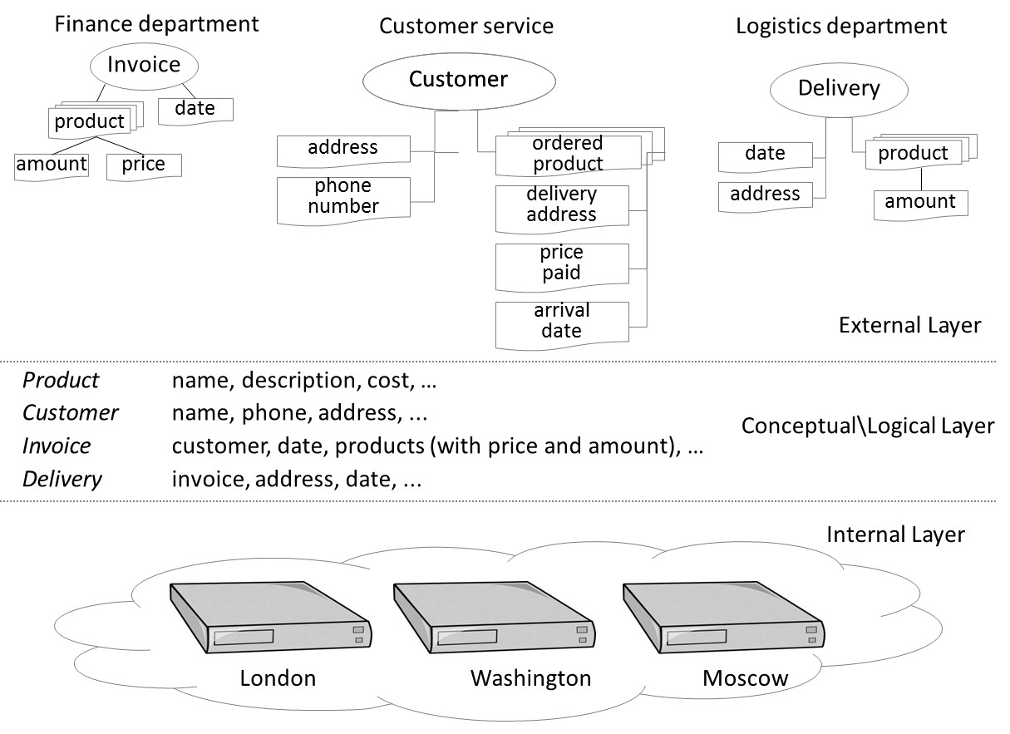
Example of the Three-Layer Database Architecture
Notes:
This figure illustrates the three-layer architecture for a procurement business process. The conceptual/logical layer defines the data items such as Product, Customer, Invoice, and Delivery.
The internal layer contains the physical storage details specifying how and where the data are stored.
The external layer has three views offering specific information to the finance, customer service, and logistics departments.

Slide 18
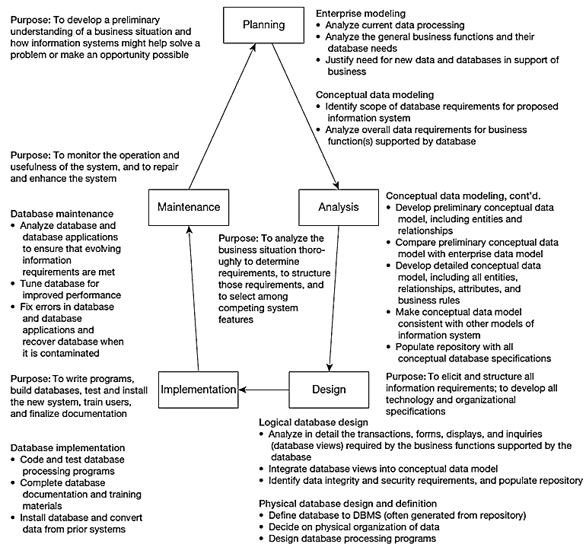
Developing a Database
Notes:
The three-layer architecture of database can be reflected in the stepwise database development approach.
The first step is planning, which involves enterprise modeling. In early conceptual data modeling, this is high level planning, most likely creating enterprise-level models, not project-level.
After planning comes a more in-depth study called analysis. The data models developed here are more detailed, including more entities, attributes, and relationships than the enterprise models. Analysis includes detailed study, interviews, requirements determinations, and document review, as well as studying the current system. The output from this involves a detailed set of specifications for what the desired system should do.
While analysis involves identifying what the system should do, the logical design is concerned with specifying how the system is going to do it. From a database perspective, analysis involves drawing the various entity-relationship data models, whereas logical design involves defining the tables, screenshots, metadata, etc., of the finalized system.
After logical design comes physical design. This can include the development or acquisition of application programs. From a database perspective, we have decided on the physical database platform (e.g. Oracle, SQL Server, mySql) and written much of the SQL for creating and manipulating our data structure.
Often physical design and implementation overlap. There’s still programming and more SQL that takes place during implementation. But other activities include installing the finished product on the production environment (previously it was only in test), and also preparing users through documentation and training. At the end of implementation is when the system is actually “up and running”.
After implementation comes maintenance. This is typically by far the longest phase, because maintenance lasts throughout the life time of the operational system. During this time there will be needs for enhancements, bug fixes, and problem-solving of various sorts. Sometimes you can think of enhancements as mini-SDLCs that produce the needed improvements to the system.
This stepwise approach is called the SDLC or a “waterfall” approach. The outputs from one phase flow down to the next. But as you can see it is also a cycle. At any stage in the process, it is possible and sometimes necessary to return to a prior stage.
The database development also can follow other approaches such as prototyping, agile development, and their several variations. But the major functional steps are the same across different methods. You will gain a deeper knowledge of different system development approaches in other courses such as systems analysis and design or project management.

Slide 19
Evolving Database Systems
Program-data independence
Ease of data access
Powerful decision support
Complex data types and structures
Notes:
Several motivations lead to the evolution of database systems, such as
Need for program-data independence in order to reduce maintenance
Desire to manage more complex data types and structures
Ease of data access for less technical personnel
Need for more powerful decision support platforms

Slide 20
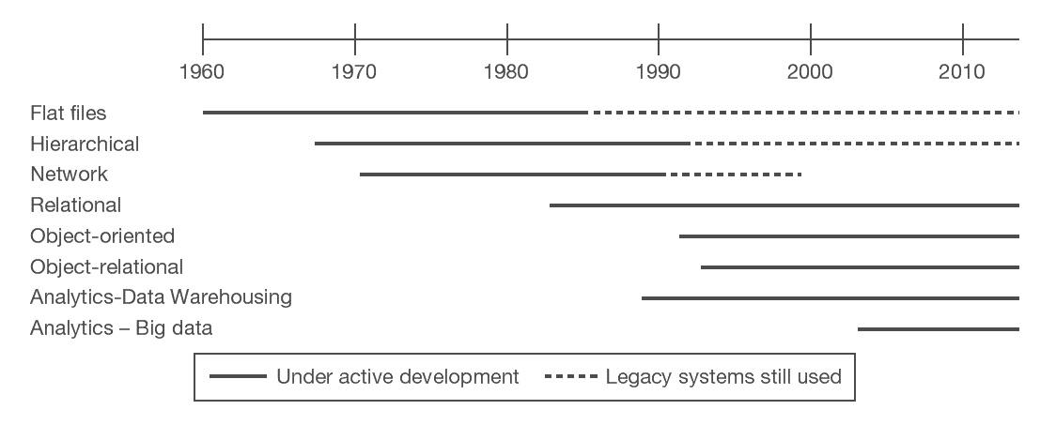
Evolution of Database Systems
Notes:
Over the years since the advent of computer data processing systems in business, there have been many approaches to database technology. We already discussed flat files and their problems. Early attempts to solve these problems led to hierarchical and network databases. Legacy systems, those initially created in the 1950s and 1960s, sometimes are still used.
The relational database is the most common form, especially for business applications. However, others also exist, including object-oriented and object-relational. Data warehousing is commonly used for managerial decision making. Recent years we have seen big data management tools to process large scale of both structured and unstructured data that is volatile.

Slide 21
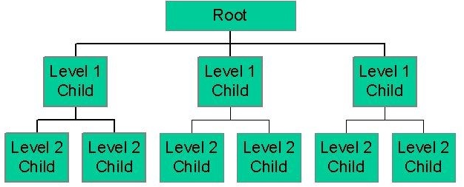
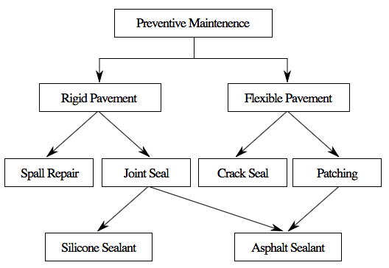
Hierarchical Database
Network Database
Notes:
The hierarchical and network database models were the earliest attempts to structure data according to relationships between entities. But they fell short because they were very inflexible. For example, many-to-many relationships are impossible in hierarchical databases; and although they are possible in network models, they are difficult to modify in these structures.

Slide 22
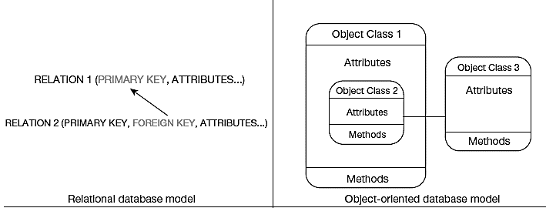
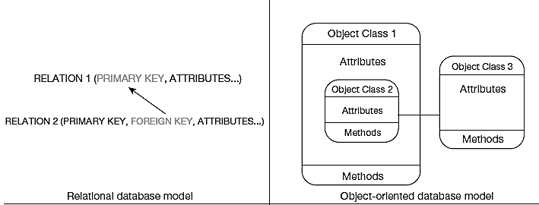
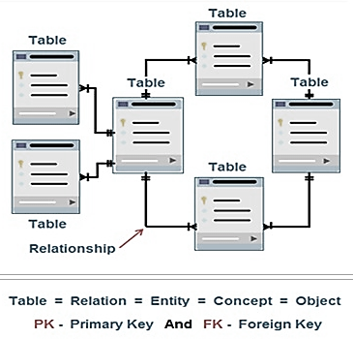
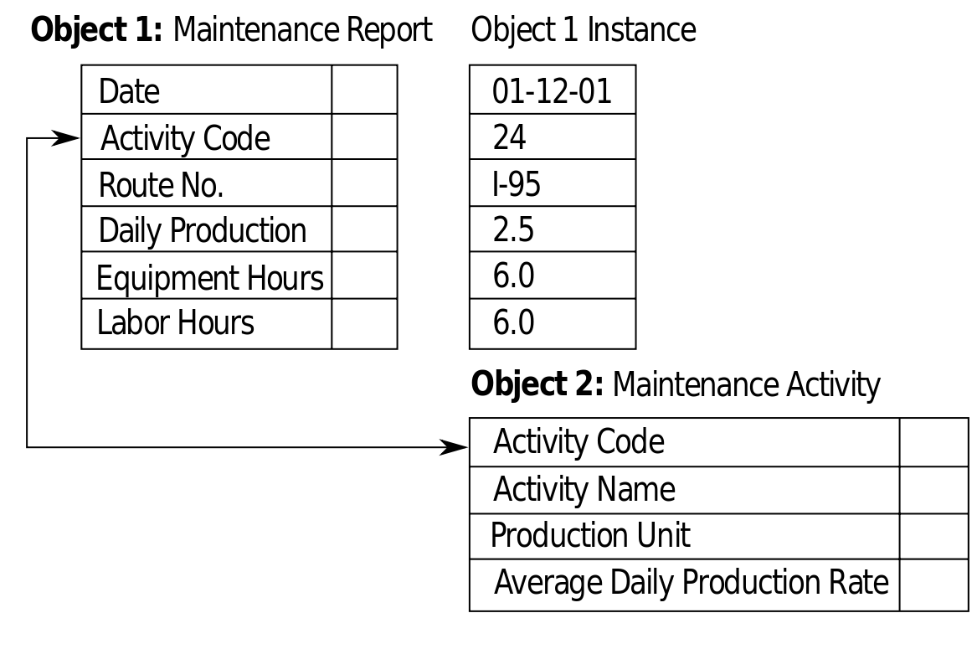
Relational Database
Object-Oriented Database
Notes:
The relational model is the most ubiquitous and represents relationships as primary-to-foreign key associations in different “relations”. Here we see some confusing terminology. There is the concept of “relationship”, which was shown as lines between boxes in the figure. And there is another concept of “relation”, which is really like a database table. We’ll see this distinction later in the course.
Object-oriented databases are interesting in that they allow for a sort of inheritance between classes and subclasses. Also, unlike relations (tables) in relational databases, objects in object-oriented databases are capable of behaviors (program code) in the form of “methods”. If you take a course in Java or other object-oriented languages, you will become familiar with these ideas.

Slide 23
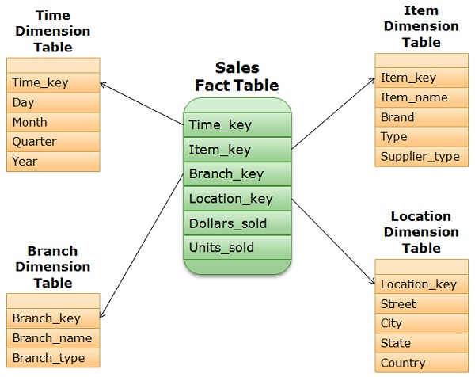
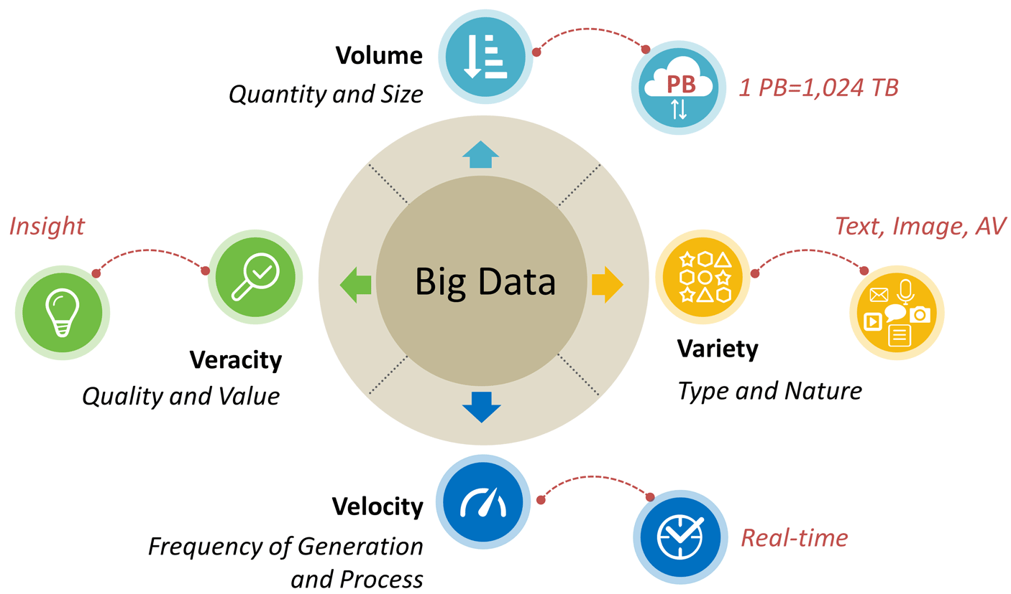
Multidimensional Database
– star-schema view
Key Characteristics of Big Data
– no predefined data model
Notes:
Multidimensional models are typically based on data warehouses and are used for decision support purposes. The star schema is a typical data warehouse structure. It’s still a relational database, but here there are two types of tables. Fact tables contain numerical data that can be aggregated (prices, sales revenue, payments, etc.). Dimensions are different “lenses” by which you can slice and dice the numerical data (customers, departments, products, time periods, etc.). The term Online Analytical Processing (OLAP) refers to the types of systems that use multidimensional data.
Big data is an emerging concern and opportunity for business. This refers to the huge amount of often unstructured data (such as tweets, customer reviews, blogs, emails, etc.) that are increasingly important for business decision-making. The Vs (volume, velocity, variety, veracity, and value) are big buzzword in the big data world.

Slide 24
Integrated Data Management Framework
 | Operational | Informational
 | Transactional | Data Warehousing | Big Data
Technology | Relational | Relational | Non-Relational
Modeling | Conceptual Data Modeling (ERD and EER) | Data Warehousing and Integration | Big Data (Hadoop, NoSQL)
Design | Logical Data Modeling (relational tables and normalization)
Access | SQL
Data Analysis | Analytics and Its Applications
Governance and Data Management | Lifecycle, Governance, and Data Quality
Notes:
The three-layer database architecture we have discussed are associated with relational database technologies and used primarily as a foundation for the design and implementation of transaction processing systems (i.e., what we called operational systems).
Data management technologies are also increasingly used as informational systems, as a foundation for analytics, or the systematic analysis and interpretation of data to improve our understanding of a real-world domain.
In this course, we will have a focus on these relational database systems and the SQL query language, as they still form the foundational source of data for almost all areas of data management. However, we also cover state-of-art data management technologies that are intended for enabling and supporting analytics. Mainly include data warehousing and big data.
This figure presents a framework that illustrates the structure and the contents of this course based on three key categories: transactional, analytical data warehousing, and analytical based big data. We will cover relational database management including conceptual data model using ERD or EER, logical data model (i.e., transforming the EER to relational tables), and SQL queries; data warehousing applications (using Tableau Prep to demonstrate the ETL process for data integration and cleaning); We also use Tableau Desktop to illustrate how we can visualize data after data processing using Tableau Prep. Finally, we introduce big data technologies including NoSQL databases and Hadoop. We may also discuss related topics such as analytics and its applications, data governance, and data ethics and security.

